Slide 1
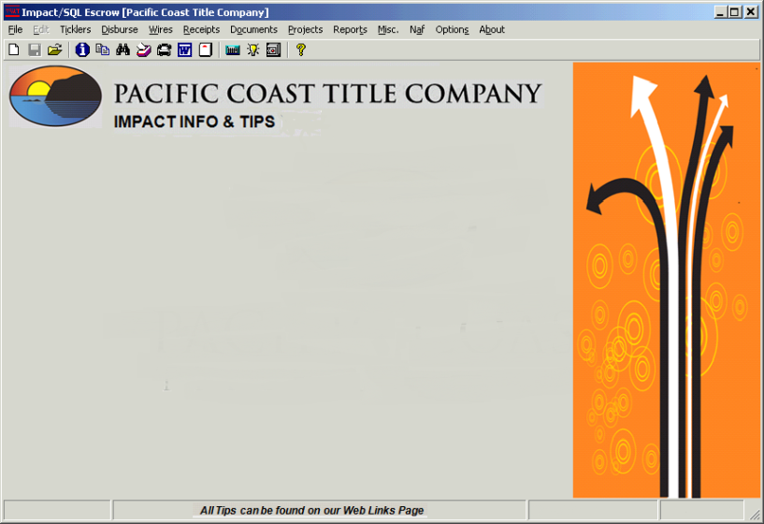

5/14/14
WIRES III TIP
5/08/14
WHEN WIRES III IS DOWN
MANUAL WIRE OUT PROCESS
DO NOT Enter WIRE OUT Into Impact’s New Outgoing Wire Screen
Create the NEW Impact Document MANUAL WIRE REQUEST
Print / Sign / Scan MANUAL WIRE REQUEST
Email MANUAL WIRE REQUEST to OAC
OAC will manually send the Wire and generate a WIO receipt into the escrow file

Slide 2
5/08/14
Impact v8.5 Tip #1
HUD Entry –Initial Deposit, new button added so additional deposits added here will roll up into HUD Line 201. Deposit schedule available when HUD is printed.
A checkbox is now on the receipt entry screen to indicate if the item being deposited is from a 3rd party. If checked, the funds will be presented separately on the HUD.
New “Parties” type added – “Escrow Company”.
Additional deposit description in the Worksheet entry, expanded from 30 characters; to 250 characters .
HUD lines 104, 105, 504, 505 on non-GFE HUD now prints Payoff Payee.

Slide 3
5/08/14
Impact v8.5 Tip #2
HUD 705-708, 809-811, 905, 1305-1307 will now only appear on the HUD if there are charges in those lines. This leaves 10 extra lines in the 1300 section before going to another page.
HUD lines - 704-708, 803-831, 902-912, 1109-1132, 1202, 1204, 1205, 1206-1220 & 1302-1339 : Users will have both “Payee Name” for checks and “Display Name” to appear on the HUD to be used if they should be different.
1099S Screen – Name field expanded to 250 characters, Address field increased to 100 characters. Note: for IRS reporting, the Name and Address fields will be truncated to match the Publication 1220 field limits

Slide 4
3/14/14
Example Attached
Redactions Are Not
On Originals
New Impact / smartVIEW Feature!
Checks & Fee Slips Created In Impact
Will Automatically Push to
smartVIEW as a Watermarked
PDF Copy of the Item
AND
They Will Be Placed in the Accounting Folder
You Will No Longer Scan These Items

Slide 5

3/13/14
Impact v8.4 – New Features!
Option to print breakdown of Seller Paid Charges from Hud Line 1102
Option to remove Buyer’s names that should not be on the HUD – Defaults to ALL Buyer names appear on HUD
Naf now pulls in work number with extension and fax number from the Parent Company if they are not entered for the Branch or Individual
Disbursement Date will auto-set to date fee slip is cut – User can change date if necessary
An “Attention To:” field was added to the Parties “Contact” screen
Title Instructions (Order Sheets) will auto-send to Marketing Reps
Accounting (OAC) can now “void” invoices as they can do with checks and fee slips

Slide 6
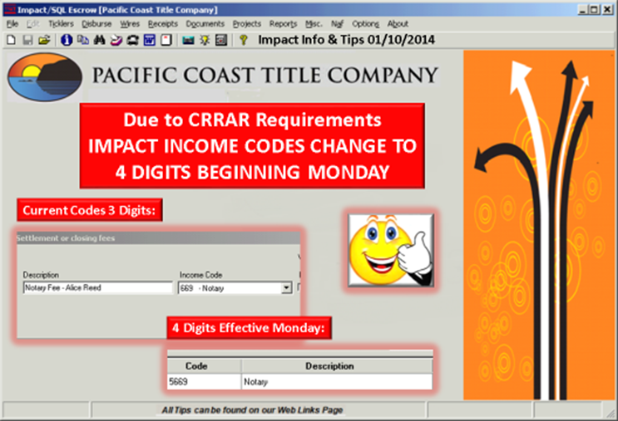

Slide 7


Impact Info & Tips 01/07/2014
A Seller Charge on the Same Line
As a Rolled-Up Buyer Charge Becomes Inactive
It Will Not Show on the HUD or Settlement Statement
The Amount Will Not Be Subtracted From The Seller’s Refund
Wrong Method of Entry
Correct Method of Entry

Slide 8
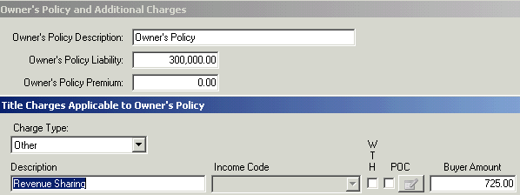
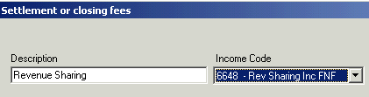
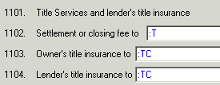
Impact Info & Tips
11/19/2013
REVENUE SHARING FOR FNF COMPANIES
Revenue Sharing
Order Type: Escrow Only
Add Outside Title Company ‘s Name to Title Information Screen in Initial Questions
Line 1103 & 1104 are to :TC
Add Additional Charge in each policy screen with Description as Revenue Sharing with Vendor’s % of the premium as a charge to either the Buyer or Seller
Line 1102: Add Additional Charge iwith description as Revenue Sharing with PCT’s % of the premium as a charge to either the Buyer or Seller. Always use income code 6648 – Revenue Sharing Inc FNF

Slide 9
10/24/2013
Wires III & Impact
When a Matched Wire Doesn’t Generate a Receipt
When the Sending Bank Doesn’t Process the Wire Through
The Federal Reserve, There is No ABA Number for Impact
WATCH YOUR WIRES III MATCHED WIRES
When a Wire Is Matched in Wires III
Verify a WIN Receipt Has Been Entered Into Your File
If No Receipt Was Entered, Contact OAC and They Will Complete
The WIN Process Making Sure A WIN Receipt Appears in the Ledger

Slide 10
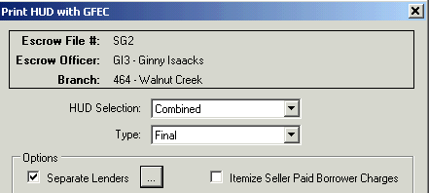
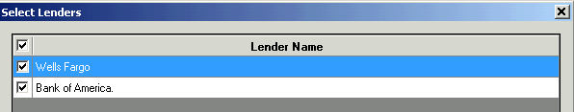




10/4/2013
WHAT’S NEW IN IMPACT v8.1
Escrow Can Print HUD for Lender 2 Only!!
Push This Button
Custom Signatures
Insert Name!
Interest Start Date
“To or Through” on Payoff Screen!
HUD Box “I”

Slide 11
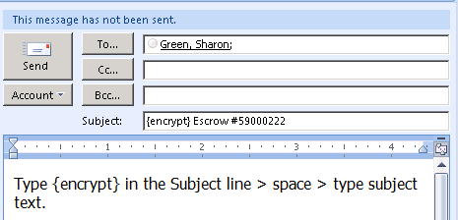
7/26/2013
OUTLOOK 2007 & 2010
EMAIL ENCRYPTION REQUIRED FOR OUTGOING EMAIL
WITH SENSITIVE CUSTOMER CONTENT
(Encryption Doesn’t Work For Email Within the Company. Our Intranet is Secure)
Type {encrypt} in the Subject line > space > type
subject text. Use upper case brackets { }

Slide 12
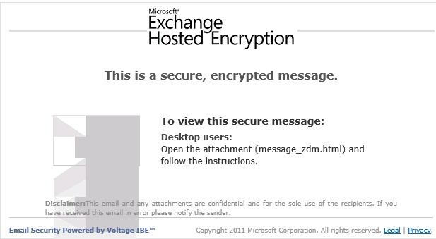
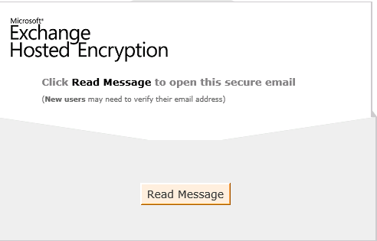
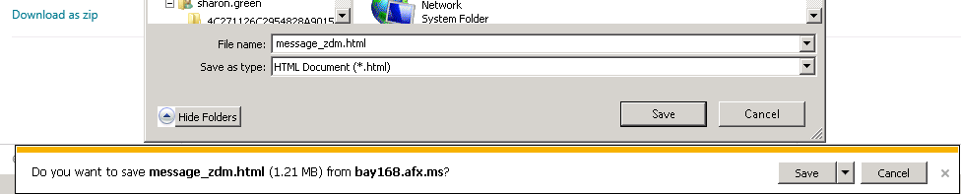
7/26/2013
CUSTOMER PROCEDURES FOR ENCRYPTED EMAIL
Recipients Will Receive:
1. Click on Attachment > Use Arrow to “Save As” >
2. Navigate to Desktop > Save >
3. Click “Open” button > Click “Read Message Button
#3
#2
#1

Slide 13
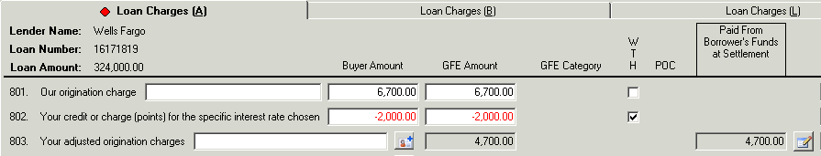
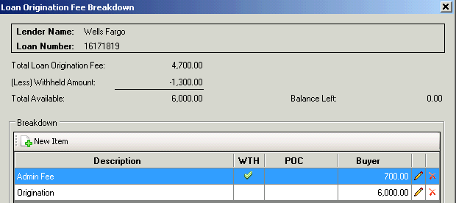
7/16/2013
Distribute the Loan Origination Charge
Press the button, on far right of HUD Line 803
EXAMPLE
$6700 Origination Chg - Not WTH on 801
$700 Lender Admin Fee – WTH on 803
$6000 Origination Fee – CK to Lender on 803
Balance Remaining - Zero
Doesn’t Show on the HUD
Doesn’t Charge the Buyer

Slide 14
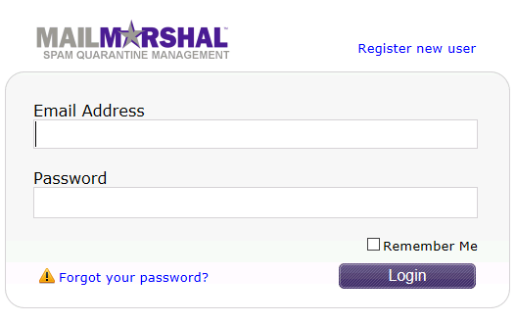
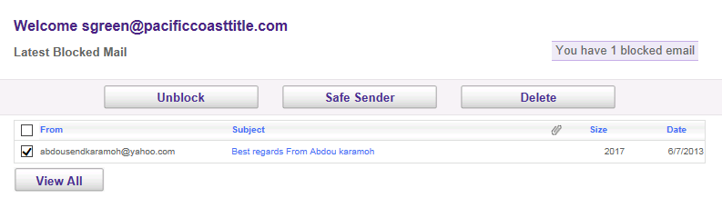
Email Info & Tips
7/09/2013
BE AWARE OF THE SPAM CONSOLE!!
When You Are Not Receiving Email From Your Customers
Check Your FNF Spam Console: https://spamconsole.fnf.com
First Step
your-email-address@pacificcoasttitle.com
Your Impact Password
Unblock it
Mark the Sender Safe
Delete Unwanted Spam

Slide 15
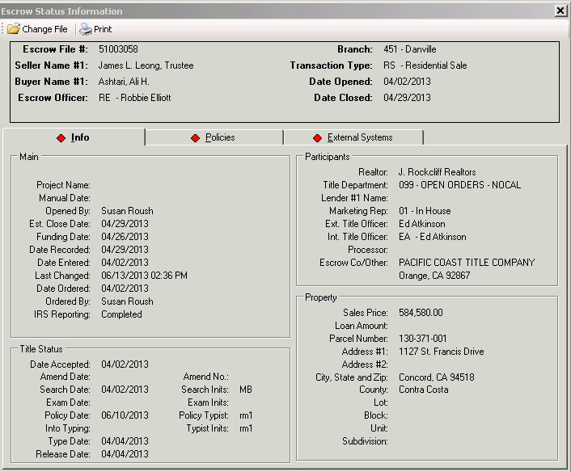
6/14/2013 Impact v8.0
Nocal
Where Is Your Prelim?
File > File Status
Title Status Section:
Date Accepted in Title
Date Searched
Prelim Type Date
Date Released to Escrow
Policy Date
Initials = Who Has the File
Diamond “Policy” Tab = Policy Typed
Diamond “External Systems” Tab
File Opened in smartVIEW

Slide 16
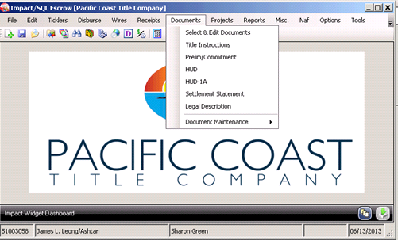
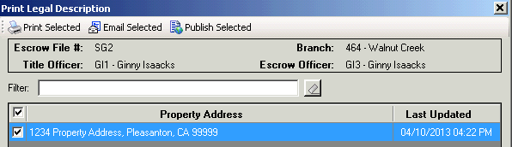
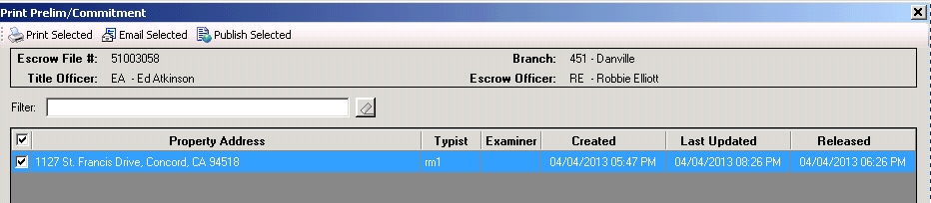
6/13/2013 Impact v8.0
Escrow Can Now
Print / Email / Publish
Prelims & Legal Descriptions
From Impact!
Nocal
Prelim Status: Date Created / Updated / Released to Escrow

Slide 17
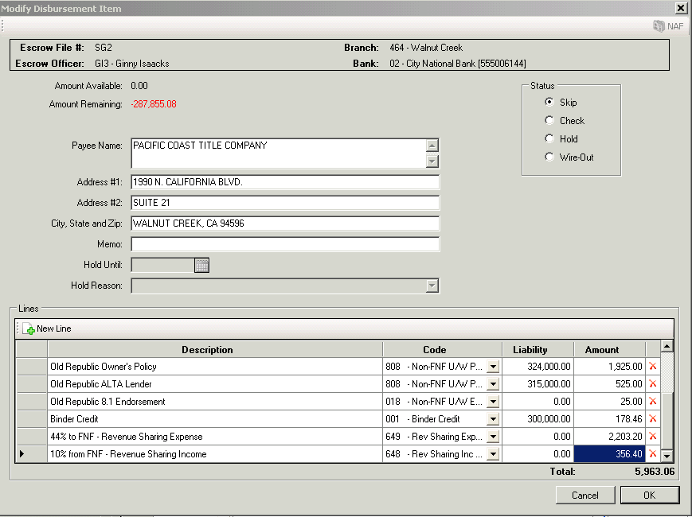
6/11/2013 Impact v8.0
BINDER CREDIT LIABILITY
REQUIRED ON THE FEE SLIP
New Income Codes to Be Aware Of
3506 Binder Credit (LIABILITY REQUIRED)
5808 NonFNF U/W – All POLICIES & ENDORSEMENTS
5808 & 018 Created for ORT Policies Issued by PCT

Slide 18
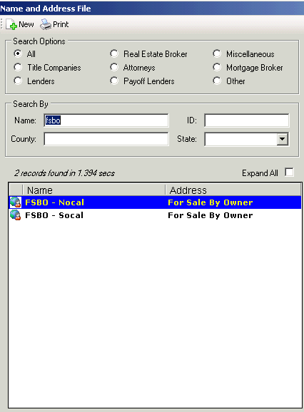
6/05/2013 Impact v8.0
The FSBO Transaction
Impact Presently Has 2
FSBO Naf Entries
1 Each For Socal and Nocal
We Use These Naf Entries
In the “Other Parties” Screen
For Source of Business
In FSBO Transactions
We Keep Our Naf Clean
Our Mgmt Reports Work Well
We Save Ourselves Time!!!
New Naf Entries Upper & Lower Case Not All Caps Please

Slide 19
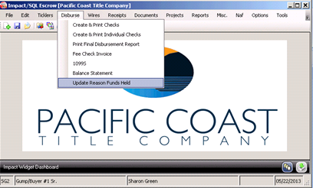
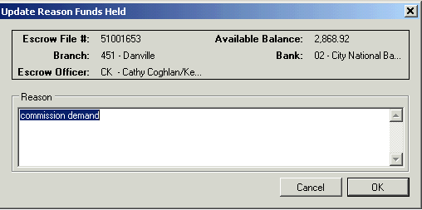
5/22/2013 Impact v8.0
Update Reason Funds Held
Do You Want to Set a Tickler?
YES – Ticklers REMIND Us To Follow-Up On Funds Held!
Funds Held Also
Appear on Trial Balance

Slide 20
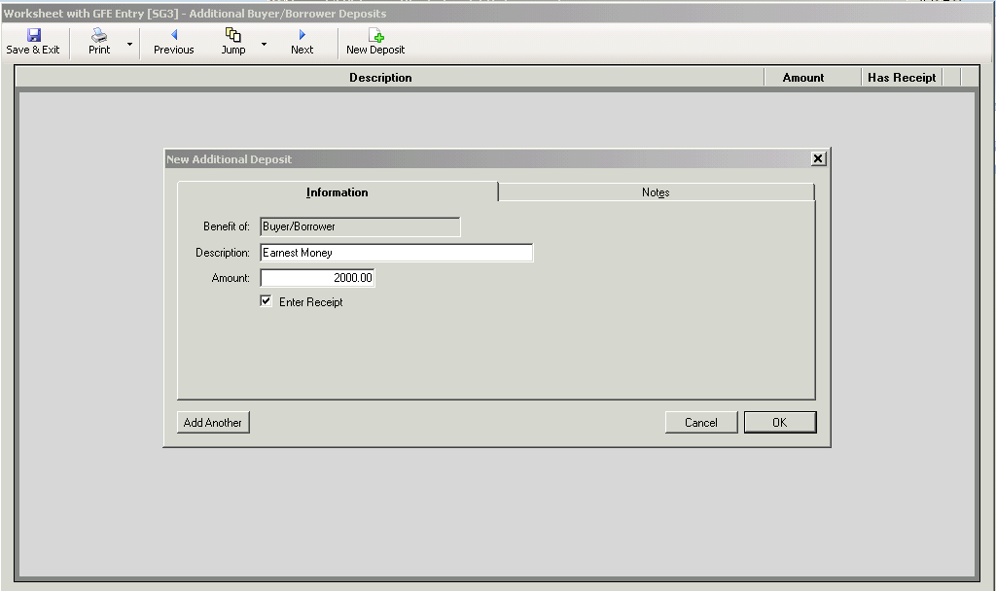
5/14/2013 Impact v8.0
WORKSHEET STYLE OF ENTRY ONLY
Audit Entry & Receipt Entry
Both in One Place!!!
Click the “Enter Receipt Box”
Click OK and Receipt Entry
Screen Comes Up
Coming Soon in v8.2
For HUD Entry Too!

Slide 21
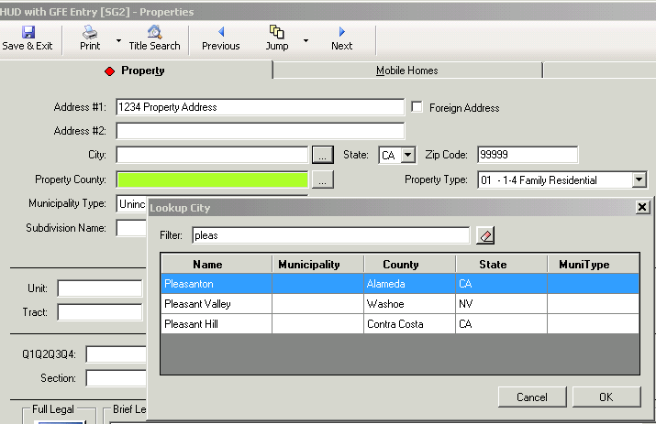
5/10/2013 Impact v8.0
Always Use City/County Lookup Tables
No More CRRAR Errors!
City/County
Link Always
Right – Spelling
Always Right

Slide 22
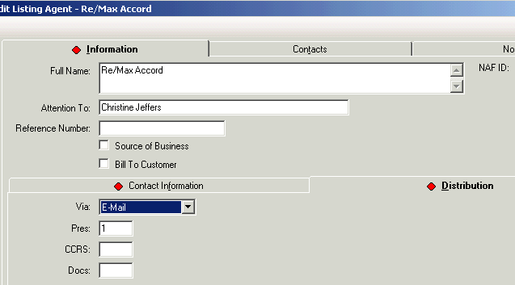
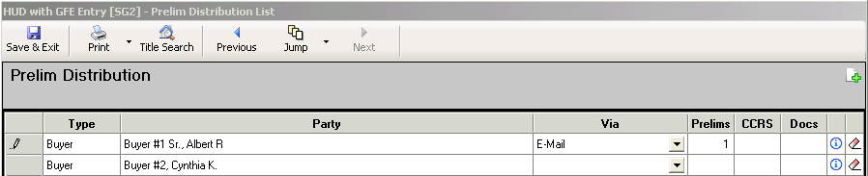

4/26/2013 Impact v8.0
Complete Prelim Distribution In Initial Questions
On Distribution Tab While Editing Parties OR
In Prelim Distribution Screen
Via? / How many Prelims
CCRS? / Docs?

Slide 23
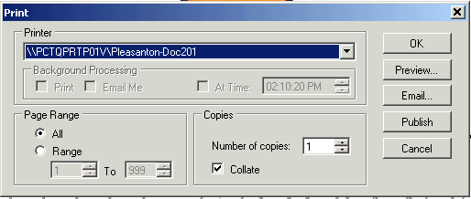
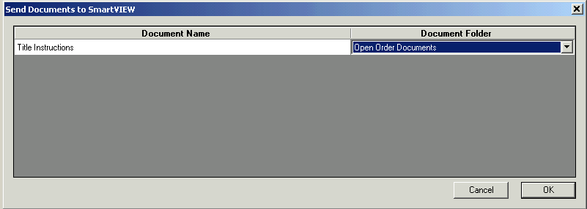
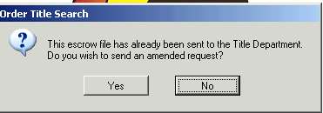
4/09/2013 Order Sheets
PUBLISH YOUR ORDER SHEETS TO SMARTVIEW
Nocal
* Documents
* Title Instructions * Publish Button
Click the No Button
Use the Drop Down Menu to Publish to Open
Order Documents

Slide 24
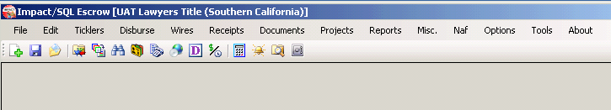
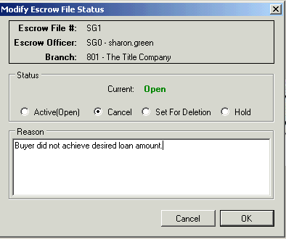
4/5/2013 Impact v8.0
BANKING MADE EASY! & MORE
Select & Edit Documents
“W” changed to “D”
One Click to Create
Deposit Slips
Nocal
To Cancel Files Properly
(File > Modify File Status > Cancel)
Impact Nocal Auto-Emails Title For You!
Files Stay On Your Open Order Report
If You Don’t Cancel Them In Impact!

Slide 25
4/5/2013 Impact v8.0
BANKING MADE EASY! & MORE
Select & Edit Documents
“W” changed to “D”
One Click to Create
Deposit Slips
Socal
To Cancel Files Properly
(File > Modify File Status > Cancel)
Files Stay On Your Open Order Report
If You Don’t Cancel Them In Impact!
Email Copy of Cancelled Order Sheet to Title

Slide 26
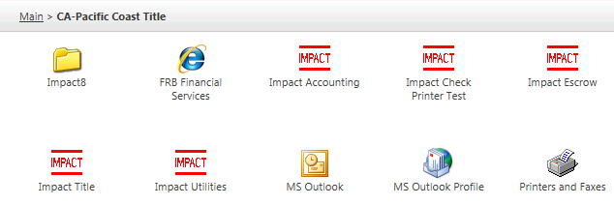
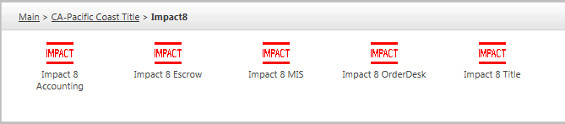
3/22/2013 Impact v8.0
ACCESS TO IMPACT8
Click Impact8 Folder
Click Impact 8 Escrow OR Impact 8 Title to Open

Slide 27

3/21/2013 Impact v8.0
1099S Reportable Transaction Types
IRS Reportable and Exchange Boxes
Will Turn Gray When Transaction
Type is Non-Reportable!!!

Slide 28
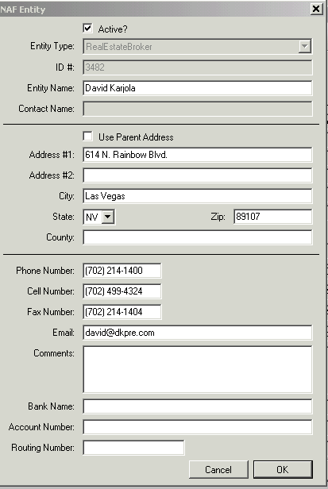
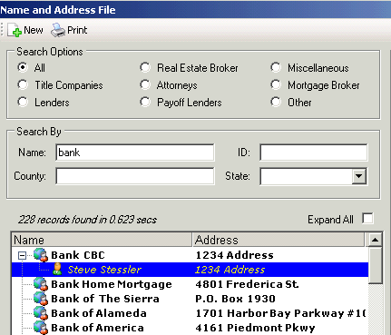
3/20/2013 Naf Is Your Tool
MODIFY THE NAF:
Box Will Pop Up So
You Can Make Changes
Naf > Add & Modify
Double Click on the Entry
You Want to Modify
FIND COMPANY NAMES
AND INDIVIDUALS!
In this example, David was the search parameter. David & all companies with individuals with the name David is pulled into the search results. A last name will drill down to more specifics.
% IS A WILDCARD!

Slide 29
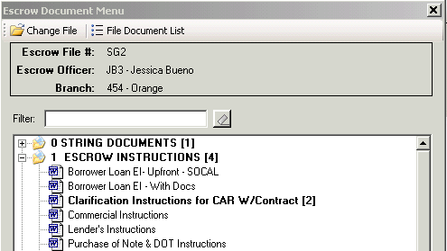
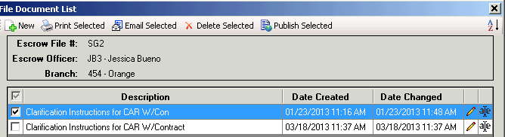
3/19/2013 Impact v8.0
New Document List Location!
Double Click to Open a Document
Bold Section W/(#): There are (1 or More)
Docs From This Section in Your Doc List
Bold Doc W/(#): There Are (1 or More) Of
This Document In Your Document List
Check the Doc You Want to Open
Notice Options Across the Top!

Slide 30
3/18/2013 Impact v8.0
Access A File While
Someone Else is In it!!!
For File Safety, Only One Person at a Time
Can Change Data In a File
(What if We Were Trying to Change the Same Thing?)
But NOW More Than One Can Access the
HUD Lines at The Same Time!
(Prompt / Do you want to view the file in “read only” mode)
As Before, When Someone Is Auditing You
Can Still Create and Edit Documents

Slide 31
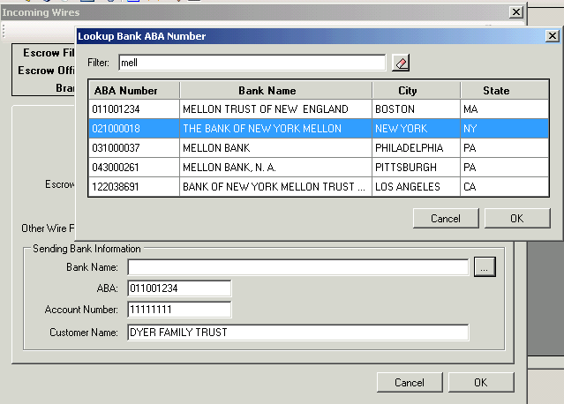
3/17/2013 New WIRE Feature!
Filter It!!!
LOOK UP TABLE FOR BANKS!!!
Auto-Fills Bank Name & ABA#

Slide 32
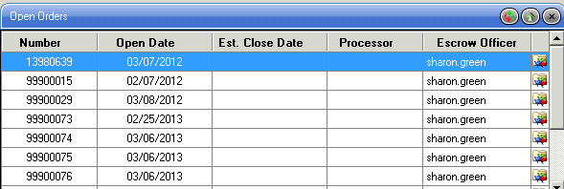
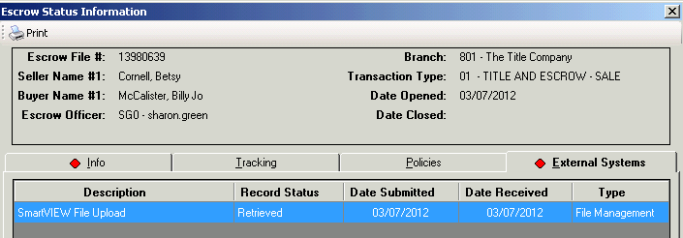
3/16/2013 Impact v8.0
Open Order Widget – Info Icon!
Published to smartVIEW? Yep!

Slide 33
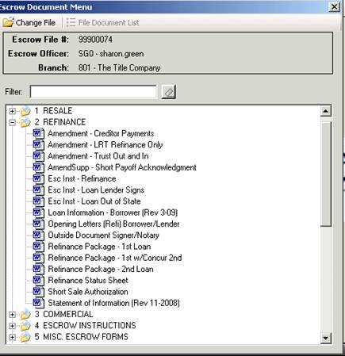
3/15/2013 Impact v8.0
Impact Document Changes
Filter Works The Same
The + Signs Open The “Tree” Just Like They Do In smartVIEW!
Double Click to Select Document
X out of the screen (no buttons)
No Other Changes To Our Documents

Slide 34
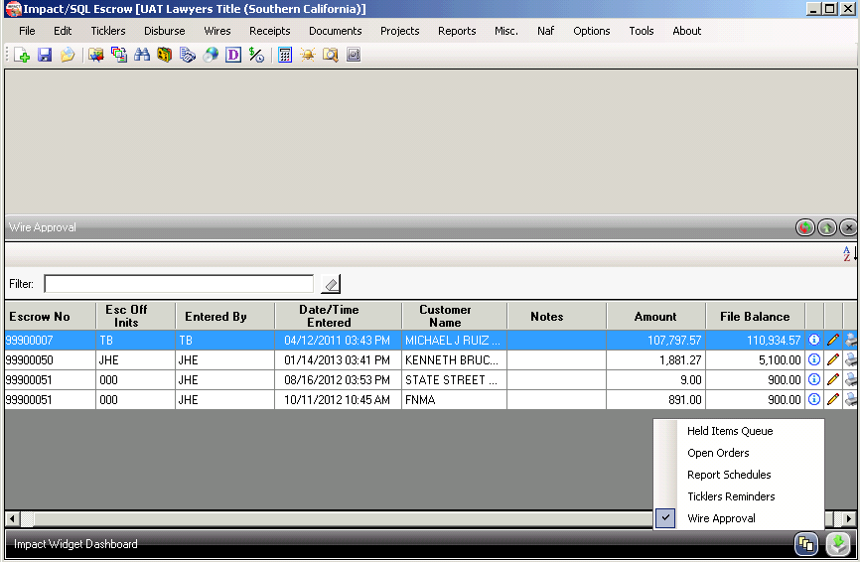
3/14/2013 Impact v8.0
“Widgets” Let You See – Held Items, Open Orders, Tickler Reminders, and Wire Out Approvals
From the Impact Splash Screen!!
Stack ‘em Any Way You Like!

Slide 35
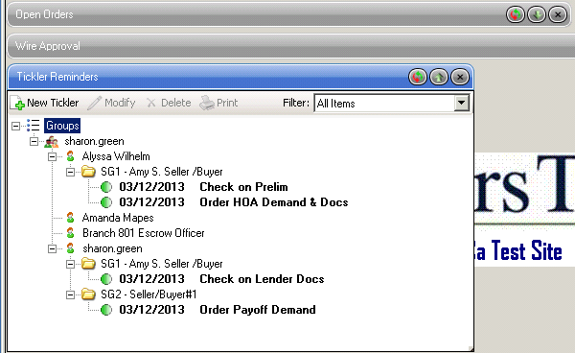
3/13/2013 Impact v8.0
IT’S A WIDGET!
Ticklers By File# - Set Up Your Group
Add Your Tickler Reminders…
Collapse Your Widgets
Make Space On Your
Impact Desktop

Slide 36
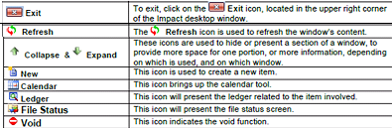
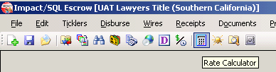
3/11/2013 Impact v8.0
New Icons & Buttons:
Impact Version 8.0!!!
Your Pointer On The Button
Shows You What It Does!
Select and Edit Documents

Slide 37
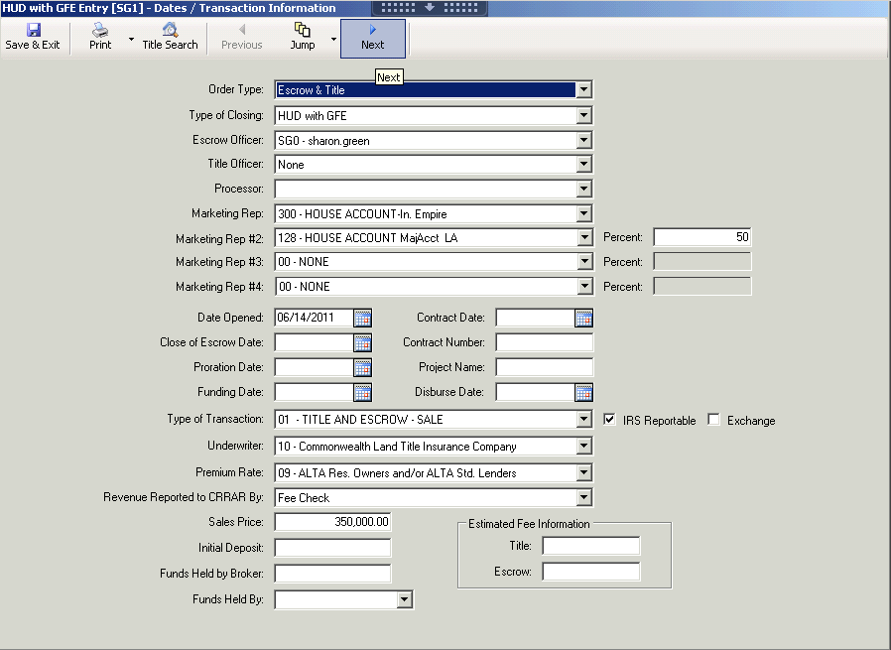
3/04/2013 Impact v8.0
An All New LOOK!
Print HUD, Settlement, Order Sheet from ANY Screen! Use the pull-down menu on the “Print” button
Jump & Next buttons on the top!
IRS Info & Funds Held IQ Screen #1
Order Title Search from any Screen!
Looks a Little Different
Works About the Same

Slide 38
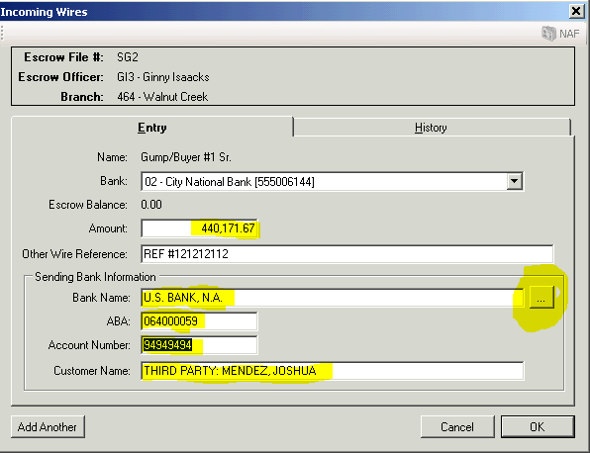
New Bank/ABA
Lookup Table

Slide 39
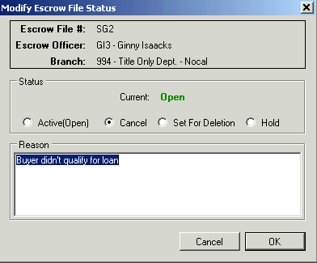
2/27/2013
CANCEL FILES IN IMPACT
Open File > File Menu
Modify File Status > Cancel
Enter Reason for Cancelling File > OK
Nocal – Impact Auto-Notifies Title
SOCAL - Type “Cancel” in Title Info Screen Comments & Email Order Sheet to T.O.
If you neglect this step cancelled files will remain on your logbook report and all Impact MIS Reports.

Slide 40
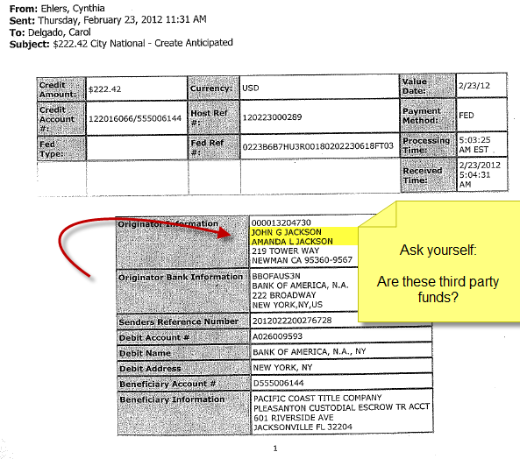
DATE 2.24.12 DEPOSITS TO ESCROW
FULL DISCLOSURE - AUDIT ISSUE RESOLVED!
Complete anticipated wire form indicating WHO you are anticipating a wire from
You will receive a bank information sheet with the detail info from OAC when wire received.
Verify originator is correct on your wire in for auditing and compliance
Third party funds? Need appropriate third party instructions
Need to show 3rd party name on HUD page one with specific $ amount deposited.

Slide 41

Date: 11.11.11
Need a Separate HUD For Your Second Lender?
Select Separate Lenders as Shown Below!

Slide 42

Naf (Name/Address File) uses “WildCards”. If you use “%” before any portion of a name, various spelling options will appear. See the example (left) with “ReMax”. Double click to “use” an entry in your party screen.

Slide 43


Date October 21, 2011
PAYMENTS TO NOTARIES
You all know Notaries are part of Settlement charges and need to be shown on HUD section 1100, right? That’s an audit exception that will pull your score down in the High Risk category.
In-house Notary Payment: Include PCT notaries in Settlement Closing Fees screen to include in Fee Ticket (income code 5669)
Insert PCT Notary Name (i.e. Notary – Jane Doe
and income code 5669
Outside Notary Payment: Put in Title Charges (B) Tab. This allows for a separate check payable to your notary. You won’t need to modify your fee ticket and if you use your NAF so you won’t need to audit your check! GFE Category > Roll up into 1101. (Put Seller Notary fees on a separate line.)

Slide 44
Date 10/6/2011
HUD REQUIRED – Who Made Deposits???
Check register, wires & deposits and HUD/closing statements must all match to pass your internal audits
Impact does not carry out depositor from the receipt/wire in
User must enter deposits made to escrow & the depositor of these funds
Each deposit should be shown on the HUD – not totaled
When a third party deposits (and you’ll catch this during your draws), that third party will be disclosed on the HUD Third party instructions are required
REMEMBER! LIST YOUR DEPOSITS &
DEPOSITOR SEPARATELY IN YOUR HUD ENTRY
REMEMBER TO PROCESS THIRD PARTY DEPOSITS CORRECTLY

Slide 45
9/28/2011
Lender’s eDocs Sent But Not Received?
They may be in the SPAM BOX!
This is different than your Outlook Junk Mail box
The link is: https://spamconsole.fnfglobal.com/
Generally emails with many links will go into this filtering application
You can add the link to your Favorites or as a desktop icon
Instructions on how to sign up and view missing emails
Have been placed on the Web links page
Jose Hill will be happy to assist in this set up
jhill@pacificcoasttitle.com or c 714.305.0994

Slide 46

9-13-11- Wires In & Out
Is Your Wire In? Did Your Wire Go Out? View Ledger: Misc > View Ledger
No need to open the escrow file to view the ledger.
You can be working in one file and view the ledger of another one.
To find out if your wires have been posted you don’t have too open the file: Misc > View Ledger
Wire Ins have been received when they show in the Receipts in Process Tab
Wire Outs have been sent when they show in the Disbursements in Process Tab
Posted Items are not today’s receipts & disbursements

Slide 47

8/17/2011 Impact
SOURCE OF BUSINESS > Parties Screen
Click On The Pencil To Edit Your Parties & Select From Naf
ALWAYS SELECT Your Source of Business (this is your customer – applicant)
NEVER CHECK or change Bill To Customer (PCT is the default BTC and credits your fees correctly)
Lender #3 (:L3) is ALWAYS Your Mortgage Broker

Slide 48
7/6/2011
Documents are added, modified or amended to your databases constantly
If you have any recommendations for your menu,
email Pat Compaglia, Sharon Green and/or Rita Nordby
When a new document is added it will be listed in the Menu in CAPS
From 4/1/13 forward, your legal description will be in Impact and will print on your documents. For files still in Trakker, you can copy your legal in Trakker and paste it into the IMPACT legal description. It will then print on all legal description fields.
When NoCal Title’s Impact integration is complete, legal description for new files will be available in Impact. See the document Exhibit “A” in our document menu.

Slide 49


5/19/11 HUD Input
There’s a text box, to the right of line 801, where you can enter any text as required by lender, including the % of origination fees or points.

Slide 50

4/26/2011 – The Word Freeze
Shift + Right
Click With
Cursor In Box
When Your Document Gets Hung Up In Word:
Position Cursor Inside The Box & Shift+Right Click

Slide 51

4/18/2011
IMPORTANCE OF LOOKUP TABLES
Use the … button as shown to access Lookup Tables
Select your City and Click OK – City & County will be inserted in the appropriate fields Transfer Taxes will ALWAYS calculate right!
City & County Transfer Tax
Will always calculate correctly!!

Slide 52
04/05/2011
Want Wire in Notifications Sooner?
Input your Wire In amount (or est amount), Customer Name, Bank Info, any other info to receive your email wire notification sooner. This helps Gina’s unit match your info to their bank wire info sooner and are the first ones to get accepted. Once accepted you receive your email notification.
Some lenders insists you show their credits in HUD section 200. Type your description (i.e. Lender Credit) and Indicate :L1 in the next box after “to” and your funding will balance in Lender’s Summary at coe.
This works in HUD lines 204 and 205 only.

Slide 53
3/03/2011
What is CRRAR & Why do you get errors?
Centralized Revenue Reporting and Accounts Receivable –
an automated application that bridges our production system to our accounting system. Income dollars and income reporting categories, such as customer, liabilities, income codes for our different accounts are extracted to the company financial reports.
CRRAR Errors are caused by:
Wrong bill to information in “Bill To Customer screen”. Must reference “CRRAR”.
A different underwriter is selected on a TE transaction.
a) When we have a TE, our underwriter must be COM or ORT.
b) If you are set up to send a separate title check, EO must be used to generate that separate check.
c) If you keep all your fees your transaction is a TE and you must change :TC to :T.
Source of Business is not pulled from the NAF
Your income cannot be recognized until errors are corrected. Your trust accountant will let you know which error you have and how to correct it. As of today we’ve clarified these instructions in escrow terms (instead of accounting terms). Sharon Green is always available to assist! sgreen@pacificcoasttitle.com.

Slide 54


2/17/2011
CERTIFY YOUR HUDS AS COPY OF ORIGINAL
User Signatures Have Been Imaged Into Impact
Call Sharon Green, cell 479-427-6114 for help!!!

Slide 55


2/15/2011
Proration Screens Are Plentiful In
Impact v8.0
Interest Calculation
Click The Calculator!

Slide 56




2/15/2011
Press Icons For Additional Functions
POC?
#2
#1
MORE PRORATE OPTIONS!
NAF > Insert Address For First
Charge > Just Copy & Paste
Name Thereafter!

Slide 57
2/03/2011
Impact Banking & NGS Banking is required each night
Complete Initial Instructions with Sale Price and Loan amount will fill in liability amounts in Fee Check screen at coe
SoCAL: Enter EO for your transaction types, and :TC for your Title Dept Fees. This sets you up to send your fees to title
NoCAL & LV: Enter TE for your transaction types. This sets you up to retain all title and escrow fees
Make sure you select the proper underwriter – COM or ORT – depending on your preliminary report

Slide 58

4/08/2010 VERIFY CK STATUS
VERIFY CHECK STATUS!
Cleared
OR
Void
Ck Detail
Misc > View Ledger
Posted Items = Posted by Accounting
Receipts in Process = Not Yet Posted
Disbursements in Process = Not Yet Posted

Slide 59


4/08/2010
VERIFY CHECK STATUS!
Red Diamonds
Indicate Activity
VERIFY CK STATUS
In Your Disbursement File
On The Checks Tab
Ck Detail

